Slide 1
PRESENTATION ON PROJECT REPORT
BY:
ALBIN BABY

Slide 2
PROBLEM STATEMENT
Coronavirus Outbreak Prediction Using Machine Learning Covid-19 Outbreak Prediction
We will analyse the outbreak of coronavirus across various regions, visualize them using charts and graphs and predict the no of upcoming cases using Linear Regression and Support Vector Machine (SVM) model in python

Slide 3
INTRODUCTION
Coronavirus (Covid-19) has become the most buzzed topic these days. Its outbreak has taken the world by storm. In this we'll see what Coronavirus is, how did it emerge, and what are its symptoms. Then, we will see what has been its impact so far and analyze the outbreak of Coronavirus across various regions, visualize them using charts and graphs, and predict the number of upcoming confirmed cases using the Linear Regression model in Python.

Slide 4
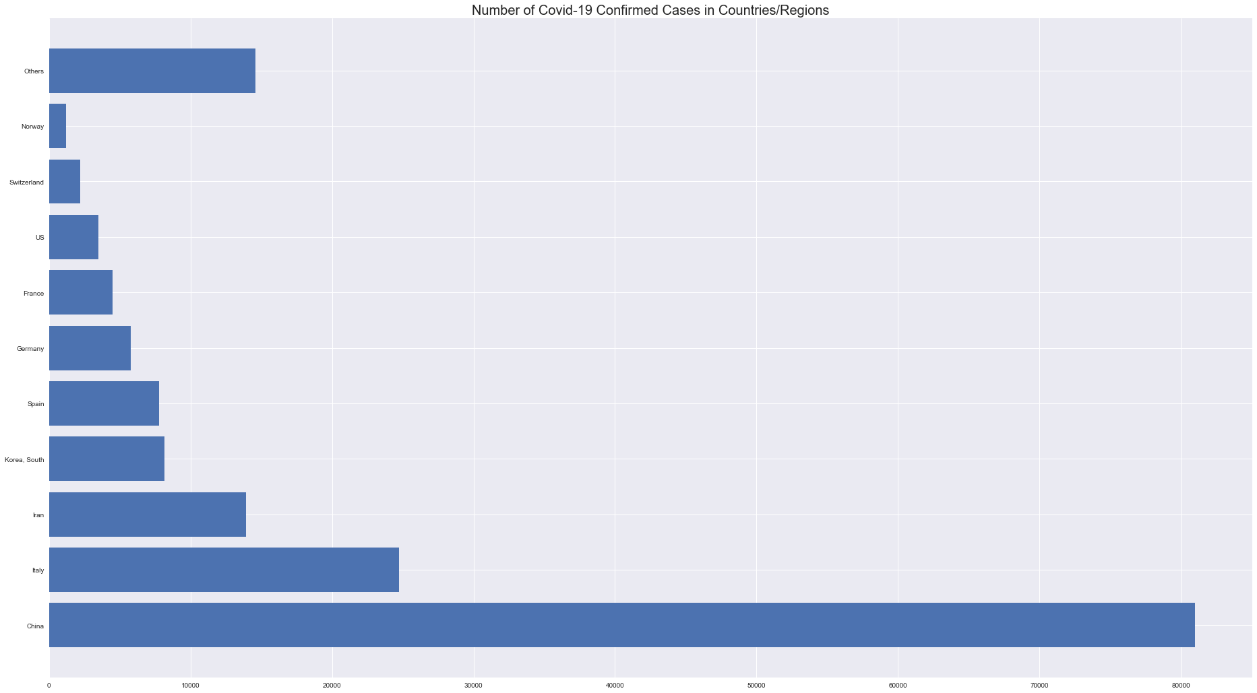
GRAPH

Slide 5
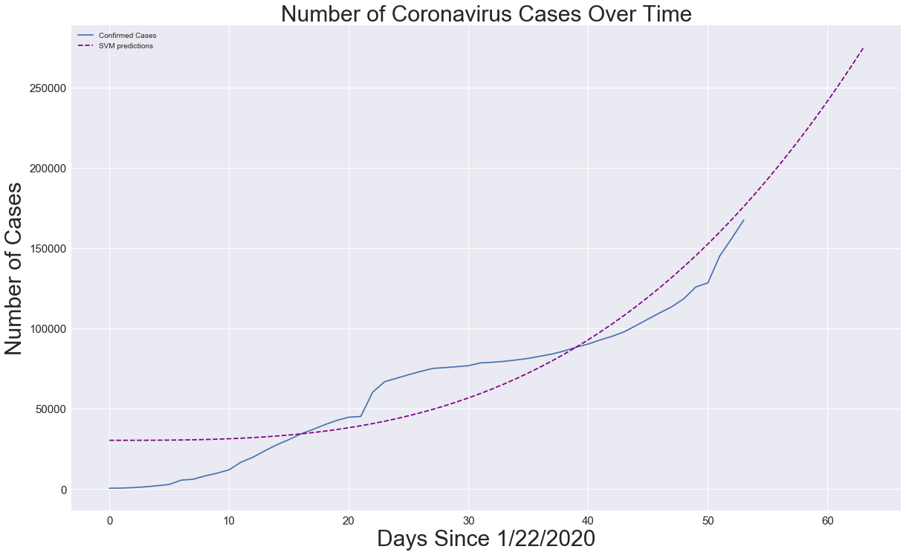
GRAPH(2)

Slide 6
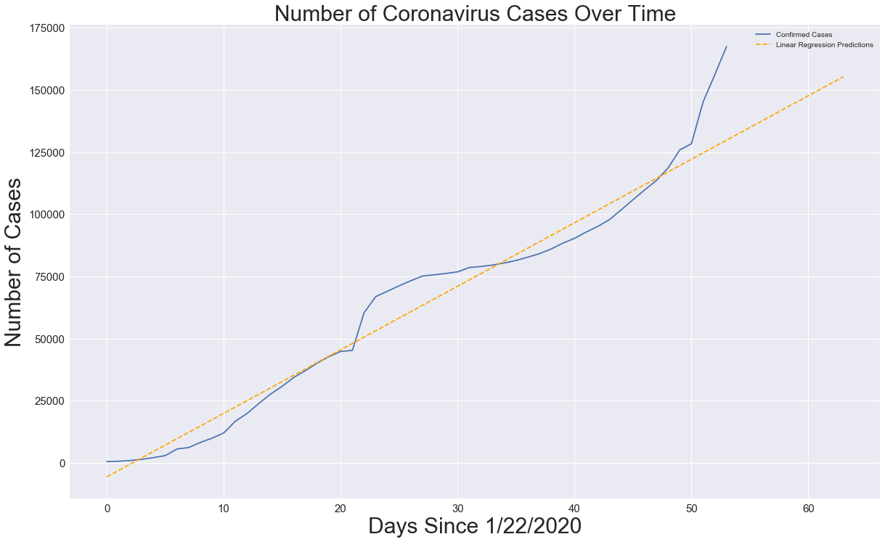
GRAPH(3)

Slide 7
METHODOLOGY
ALGORITHMS
> Linear Regression
why linear Regression ?
Linear regression analysis is used to predict the value of a variable based on the value of another variable. The variable you want to predict is called the dependent variable. The variable you are using to predict the other variable's value is called the independent variable.
X = input variable (also called independent variable)
Y = output variable (also called dependent variable)
> Support Vector Machine(SVM)
:-paratmeters used : kernal, c, gamma, epsilon, shrinking, svm_grid
Why SVM?
SVM Classifiers offer good accuracy and perform faster prediction compared to other algorithms. They also use less memory because they use a subset of training points in the decision phase. SVM works well with a clear margin of separation and with high dimensional space.

Slide 8
FINDINGS
Total number of confirmed cases (1-22-2020) to (3-13-2022) is 167499
Total number of death cases (1-22-2020) to (3-13-2022) is 6440
Total number of death cases (1-22-2020) to (3-13-2022) is 76034

Slide 9
REFERENCE
:- Data set from simplilearn website
:- Reference video from youtube channel
(simplilearn)

